Slide 1
Presentation and progress on the IOT Satellite case study
Professor:
Alfredo Grieco
PhD researcher :
Antonio Petrosino
Students:
Daniele Semeraro

Slide 2
Index
Introduction
What is CubeSat
Software-Defined Networking (SDN) and Network Function Virtualization (NFV)
Satellite Virtual Network Functions Optimization (SVNF)
Solution of the problem

Slide 3
1. Introduction
Satellite Virtual Network Functions Optimization is an emerging technology that allows you to optimize the use of CubeSats, reducing costs and simplifying operations.
In this presentation, we will see Software-Defined Networking (SDN) and Network Function Virtualization (NFV) and how this technologies can help make satellite communication more efficient and improve the performance of CubeSats.

Slide 4
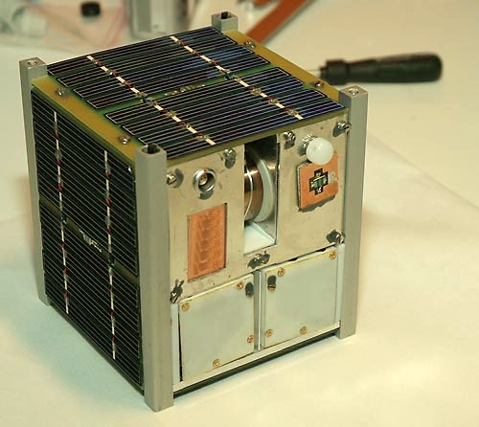
2. What is CubeSat
A cubesat is a type of miniaturized satellite having a cubic shape, a volume of 1 dm³ and a weight < 2 kg.
The term "cubesat" denote not only the nanosatellites but it described the type of satellites in the CubeSat project.
They are cheap and are made using COTS* components.
*COTS = Commercial Off-the-Shelf component

Slide 5

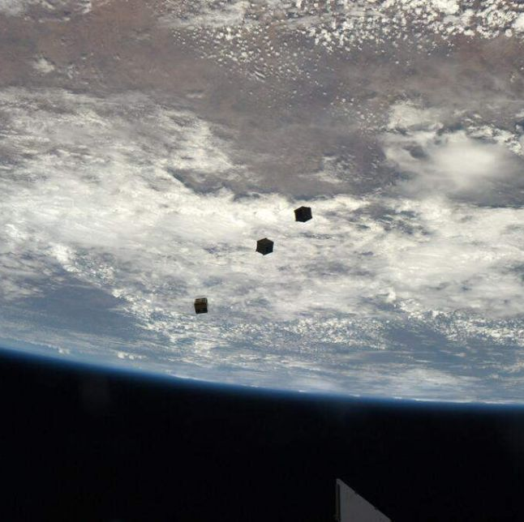
Why use a CubeSat:
They orbit at 500 km from the earth and are used for:
Remote sensing
Communications
Scientific experiments
Biological research
Missions to the Moon

Slide 6
3. Software-Defined Networking (SDN) and Network Function Virtualization (NFV)
SDN (Software-Defined Networking) is a network architecture that separates network control from data packet forwarding, in order to create greater flexibility and agility in managing networks.
Network Function Virtualization (NFV) is the concept of using IT virtualization technologies to virtualize entire classes of network node functions into building blocks that can be connected to create communication services
Notes:
SDN (Software-defined networking) è il concetto che consente di controllare, modificare e gestire in modo dinamico il comportamento della rete in modo programmatico tramite interfacce aperte e l'astrazione di funzionalità di livello inferiore.
NFV (Virtualizzazione delle funzioni di rete) è il concetto di utilizzare le tecnologie di virtualizzazione IT per virtualizzare intere classi di funzioni dei nodi di rete in elementi costitutivi che possono connettersi per creare servizi di comunicazione.

Slide 7
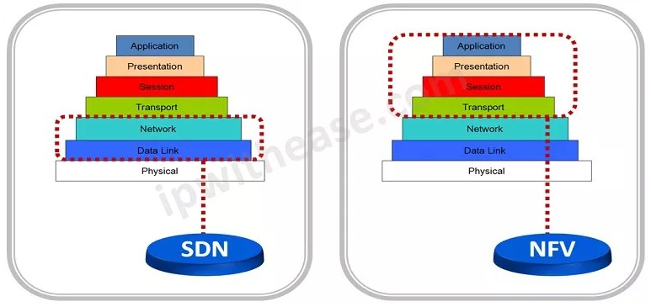
3. Software-Defined Networking (SDN) and Network Function Virtualization (NFV)

Slide 8
Software-Defined Networking (SDN)
Software-defined networking (SDN) is the concept of dynamically controlling, changing, and managing network behavior programmatically through open interfaces and abstraction of lower-level functionality.
The advantages are:
create dynamic and customized network policies more efficiently,
simplify network management,
enable the use of network devices from different vendors,
and reduce operating costs.

Slide 9
Network Function Virtualization (NFV)
NFV (Network Function Virtualization) is a network function that is implemented and managed in software rather than through dedicated hardware.
This means that instead of using specific hardware devices to perform network functions such as routing, firewalling or application acceleration, NFVs are run in virtualized environments, such as virtual machines or containers.

Slide 10
4. Satellite Virtual Network Functions Optimization (SVNF)
The SVNF use the two techniques mentioned to improve the performance of the satellite network using virtualization and VNF optimization techniques.
The aim of SVNFO is to improve the efficiency of the satellite network, reduce latency times and improve the quality of service for end users.
Notes:
Satellite Virtual Network Functions Optimization (SVNFO) è una tecnologia che si concentra sull'ottimizzazione delle funzioni di rete virtuali (VNF) su una rete satellitare.
In pratica, la SVNFO cerca di migliorare le prestazioni della rete satellitare utilizzando tecniche di virtualizzazione e di ottimizzazione delle VNF, come ad esempio l'allocazione delle risorse, la pianificazione del traffico e la gestione della qualità del servizio.
L'obiettivo finale della SVNFO è quello di migliorare l'efficienza della rete satellitare, ridurre i tempi di latenza e migliorare la qualità del servizio per gli utenti finali. Ciò è particolarmente importante in applicazioni che richiedono una connessione affidabile e a bassa latenza, come le comunicazioni satellitari per le applicazioni militari, per la navigazione aerea e marittima, per le comunicazioni in aree remote e per l'Internet delle cose (IoT) satellitare.

Slide 11
5. Case study
Important goals of the case study that are done are:
Defined the architecture:
The satellites and their structure
The orchestrator (gateway) and its structure
The clusters and their structure
Constellation and its structure
Services and VNFs
Create a simulation environment that simulates the space segment, including the satellites VNFs, the Allocation Services Matrix

Slide 12
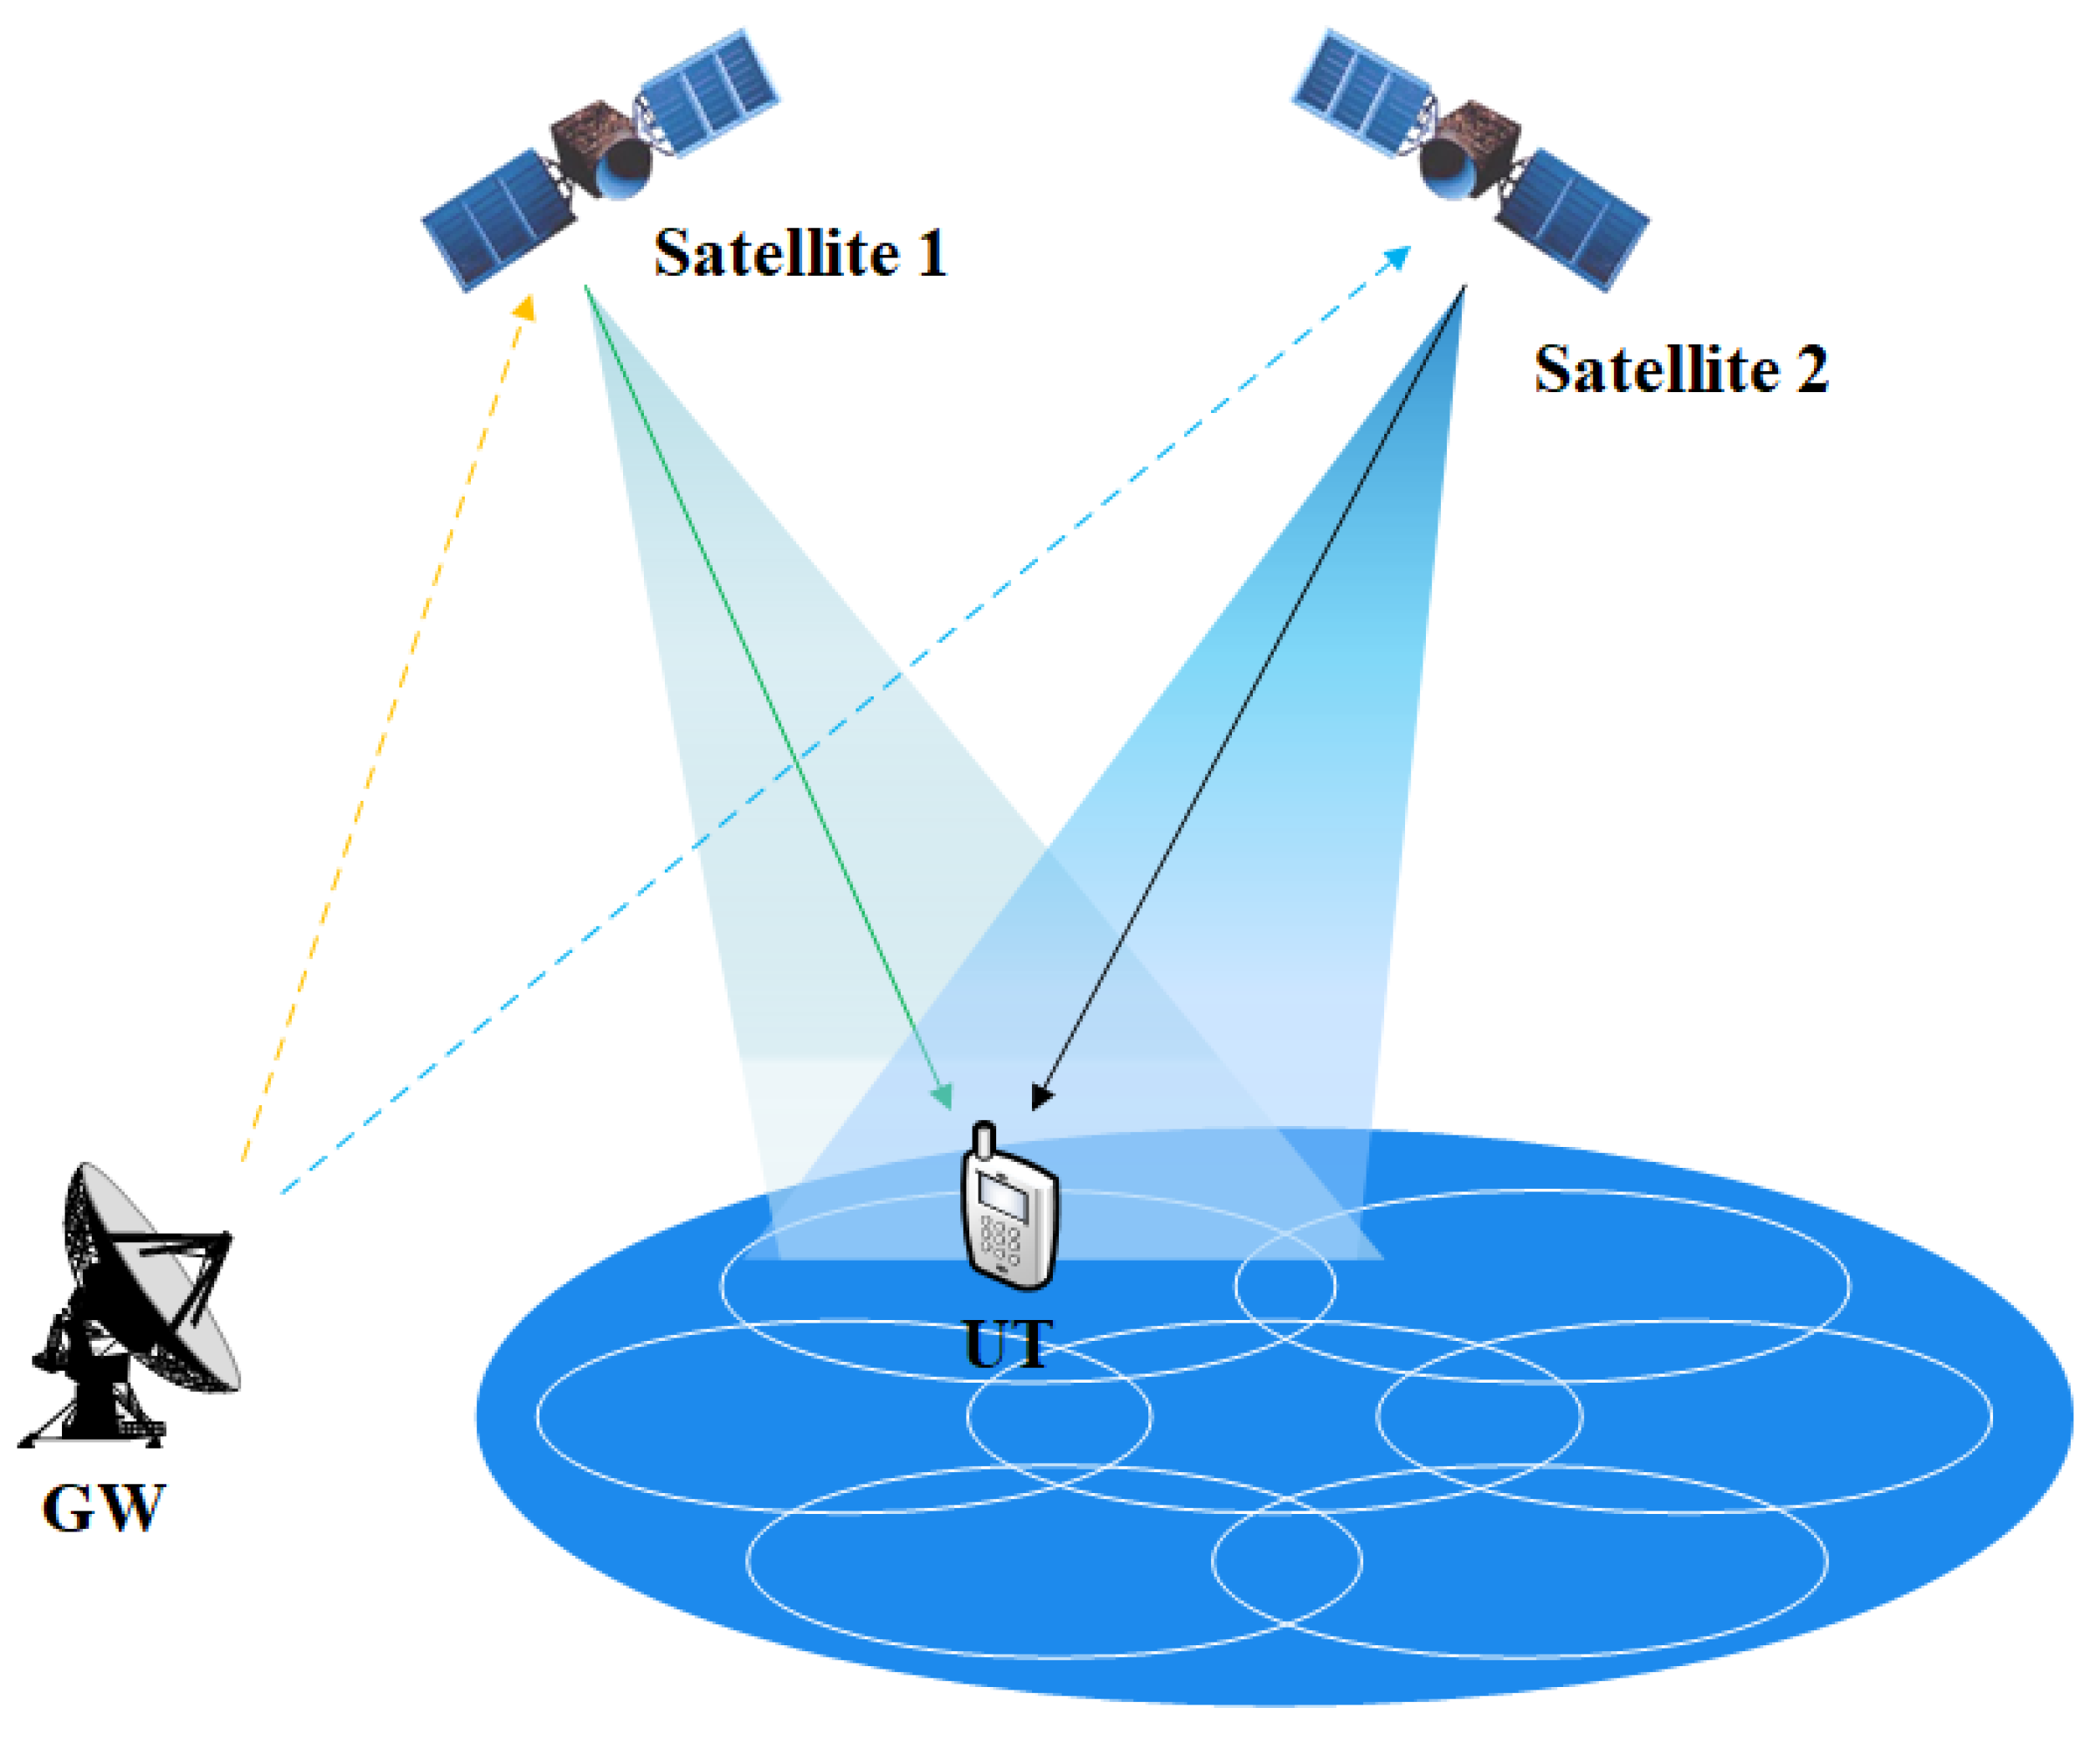
Example of the environments designed

Slide 13
And now?
Implement the optimization algorithm: implement an optimization algorithm that optimizes the VNF allocation based on the objectives and constraints
Define the performance metrics to evaluate the optimization algorithm, such as the VNF utilization, the communication latency, and the power consumption
Evaluate the optimization algorithm: run the simulation with different optimization algorithms and evaluate their performance using the defined metrics

Slide 14
Thanks for the listening
References:
CubeSats:
https://en.wikipedia.org/wiki/CubeSat
https://www.esa.int/Enabling_Support/Preparing_for_the_Future/Discovery_and_Preparation/CubeSats
SDN and NFV:
https://ipwithease.com/sdn-vs-nfv/

